Slide 1
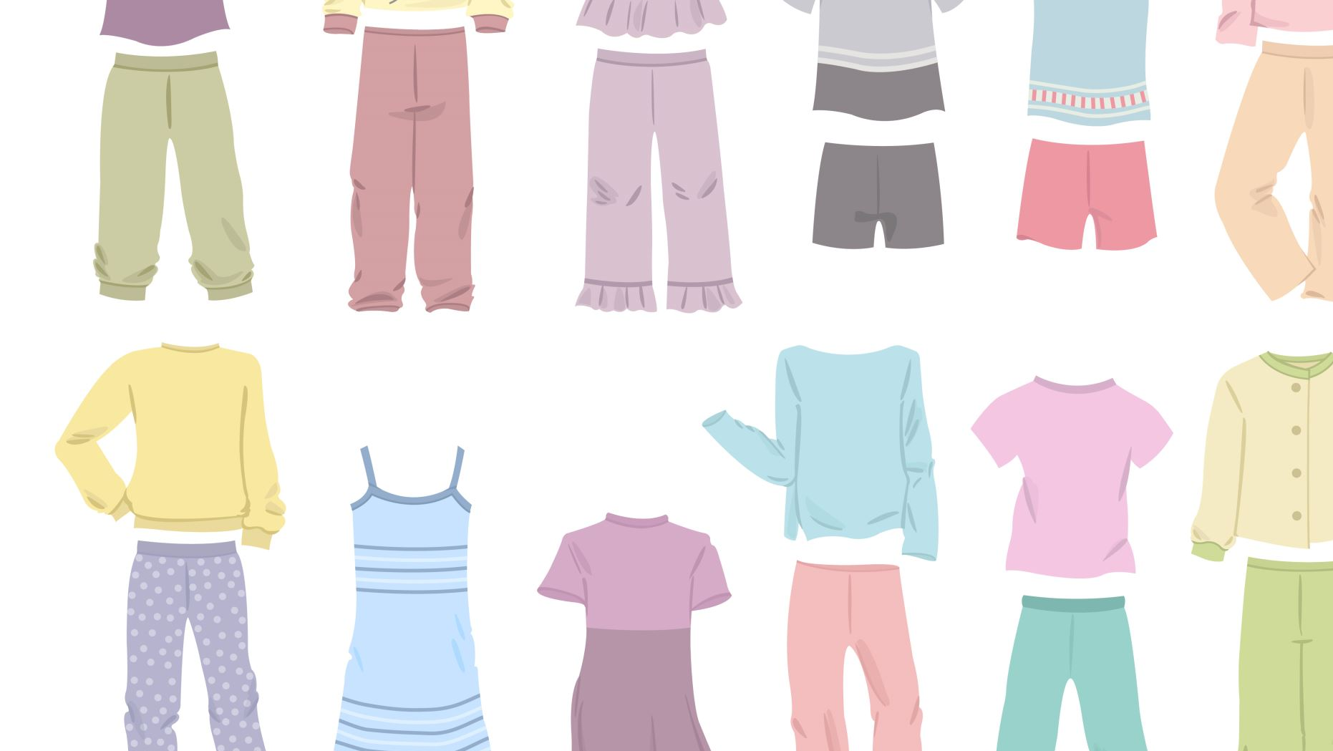
Spartan Thrift
Group 03
Adrian Aldridge
Gloria Sukidi

Slide 2
What is Spartan Thrift?
Spartan Thrift is an application for UNCG students to thrift online. Students can register as providers capable of listing products for sale or customers who may purchase products.

Slide 3
Provider Use-Cases + Demo
A provider must register through the provider portal which grants them the following capabilities:
Modify personal and shop profile
Add items for sale with images, a description, and prices
Remove and update items.
View shop statistics
Reply to customer reviews

Slide 4
Customer Use-Cases + Demo
A customer must be able to register through the customer portal which grants them the following capabilities:
Modify personal profile
View available items
Add items to a cart or wish-list
Leave reviews on products they've bought

